Slide 1
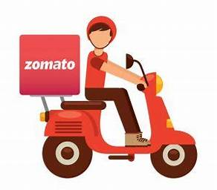

Zomato Case Study Business Model & Revenue Generation
By Shivani Dashore

Slide 2
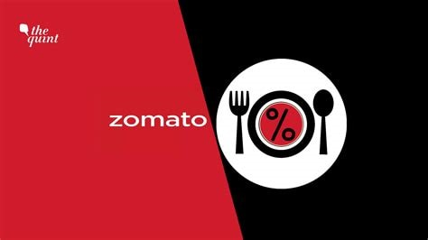
Content
Overview
Business Model
Market Positioning
Revenue Streams
Conclusion

Slide 3
Company Overview
Started in 2008
Presence in 24 Countries
Market leader in 18 countries
14 lacs Restaurants Listed
10,000 cities
120 Millions Customer(12 Crs)
Stock price jump 65%
Market Valuation 1,08,000 Crore

Slide 4

Founder
Mr. Deepinder Goyal
Parents are teacher
IIT Delhi, Maths & computing
Consultant at Brain & Co.
Current Net worth $650 million (4800 Cr.)

Slide 5
Starting
In 2008, he just scanned the menus and uploaded
He also involved his friend and colleague Pankaj Chaddha
After great response he started doing that for Delhi NCR
Registered Company in name “Fooddiebay.com”
It had around 2 million visitors and 8000 restautrants listed
Restaurants started approaching for Advertisement

Slide 6

Business Model
Zomato's business model is like a matchmaker for foodies and restaurants. It works like this:
Online Platform: Zomato provides a user-friendly app and website where hungry people can explore a vast selection of restaurants and their menus.
Order Placement: Customers can place food orders through the app or website.
Delivery or Pickup: Zomato arranges for the food to be delivered to the customer's doorstep or for pickup.
Partnering with Restaurants: Zomato partners with restaurants, helping them reach a broader audience and offer food delivery services.

Slide 7
Market Positioning
Zomato's secret sauce lies in its market positioning:
Food Discovery Hub: Zomato isn't just about food delivery; it's a food discovery platform. Users can explore various cuisines, read reviews, and discover new restaurants.
Extensive Choices: Zomato offers an extensive list of restaurants and cuisines, ensuring there's something for everyone.
Convenience: Zomato places a strong emphasis on user convenience, making it easy for people to order food with just a few taps on their smartphones.
Competition: In a competitive market, Zomato competes with other food delivery apps like Swiggy and Uber Eats (now part of Zomato).

Slide 8
Revenue Streams
Zomato's income recipe includes several ingredients:
Commission from Restaurants: When you order food from a restaurant through Zomato, the restaurant pays Zomato a commission for connecting them with customers.
Zomato Gold: Zomato offers a subscription-based service called Zomato Gold, where users get special discounts at partner restaurants, and Zomato earns from these subscriptions.
Advertising and Promotions: Restaurants pay Zomato for advertising and promoting their menus on the platform.
Delivery Fees: Customers might pay a small fee for the convenience of having their food delivered to their doorstep.
Cloud Kitchens: Zomato also operates cloud kitchens where it prepares and delivers food under its own brand name.

Slide 9
Conclusion
In a world where convenience is king, Zomato's business model, focus on food discovery, and diverse revenue streams have made it a global success story.
By connecting people with their favorite foods and restaurants, Zomato has become an integral part of the modern dining experience.
As we've seen in this case study, Zomato's journey from a small startup to a global food tech giant is a testament to its innovative approach to the food delivery industry.
This case study showcases how Zomato's simple yet effective business model, market positioning, and diversified revenue streams have contributed to its remarkable success in the food delivery industry.

Slide 10
